Slide 1
Ulwazi malunga nokungasebenzi (kwamayeza) e HIV

Slide 2
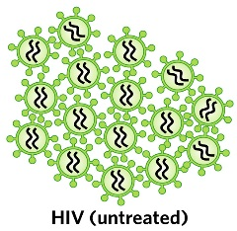
Kukuthini ukungeva?
Xa umntu ethi osuleleke yi HIV, intsholongwane ingena emzimbeni womntu ize iqalise ukuziphindaphinda.

Slide 3
Kukuthini ukungeva?
Amayeza asetyenziswa ukunyanga i-HIV abizwa ukuba zizithomalalisi ntsholongwane (i-ARVs).
Notes:
Ukuthatha i-ARVs ngendlela efanelekileyo kudla ngokuthetha ukuthatha amayeza e-ARV awohlukeneyo ama-3, kuba kuthatha ngaphezu kweyeza le-ARV elinye ukunqanda i-HIV ekuziphindaphindeni.

Slide 4
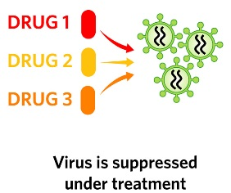
Kukuthini ukungeva?
Xa zithathwa kakuhle, i-ARVs zinqanda intsholongwane ekuziphindaphindeni zize zincede abantu abane-HIV bazive bengcono kwaye baphile ixesha elide.

Slide 5
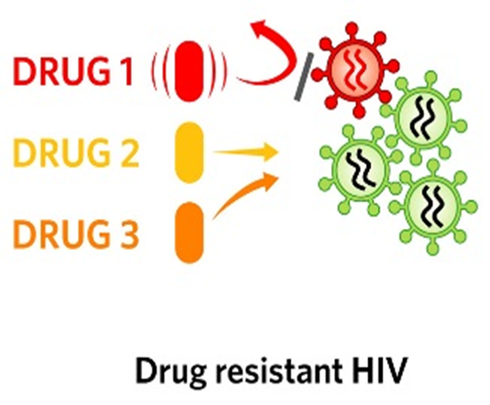
Noko kunjalo, i-ARVs azigqibelelanga, kwaye ngamanye amaxesha azikwazi kunqanda zonke iintsholongwane ze-HIV ekuziphindaphindeni.
Kukuthini ukungeva?

Slide 6
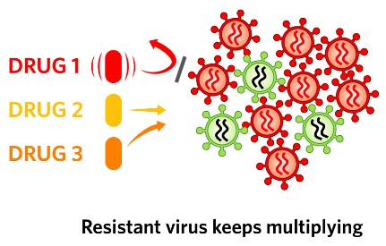
Xa oku kusenzeka, i-HIV ekwazi ukuqhubeka nokuziphindaphinda kuthiwa “ayiva mayeza.”
Kukuthini ukungeva?

Slide 7
Kutheni ukungasebenzi kwamayeza e-ARV kuyingxaki nje?
Xa kusenzeka ukungasebenzi kwamayeza, umntu kufuneka ayeke ukuthatha i-ARV engasasebenziyo aze aqalise ukuthatha iyeza le-ARV elahlukileyo.

Slide 8
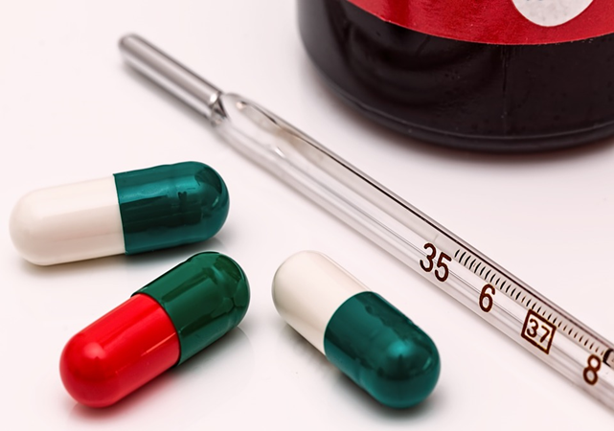
Kutheni ukungasebenzi kwamayeza e-ARV kuyingxaki nje?
Ngenxa yoku, umntu one-HIV engavi mayeza uneendlela ezimbalwa zokukhetha amayeza e-ARV anokuzithatha ukuze zimncede ahlale ephilile.
Ukongeza, bangosulela abanye ngentsholongwane engevi mayeza.

Slide 9
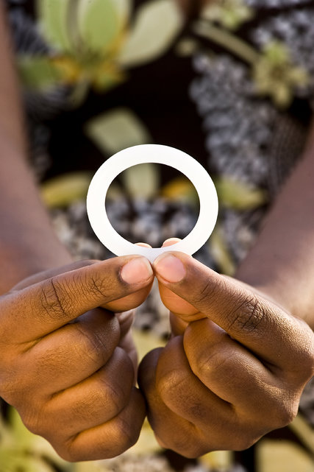
Kutheni ukungasebenzi kwamayeza e-ARV kuyinxalabo kolu phononongo lophando?
Iringi efakwa ekukwini iqulathe i-ARV ekuthiwa yi-dapivirine. I-daprivine isetyenziselwa ukuthintele i-HIV kuphela, kwaye ayisetyenziselwa ukunyanga abantu abosulelwe yi-HIV.

Slide 10
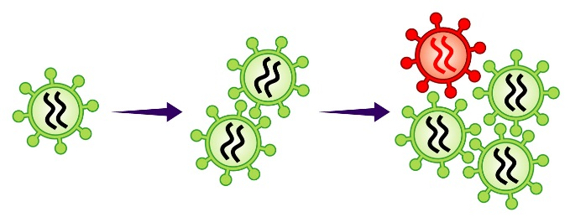
Kutheni ukungasebenzi kwamayeza e-ARV kuyinxalabo kolu phononongo lophando?
Noko kunjalo, ukuba owasetyhinilwe-HIV aze athi gqolo esebenzisa iringi, intsholongwane esemzimbeni wakhe isenokungayiva i-dapivirine namayeza afana ne-ARV asetyenziswa ukunyanga i-HIV okanye ukuthintela usulelo lwe-HIV olusuka kumama luye emntwaneni.

Slide 11
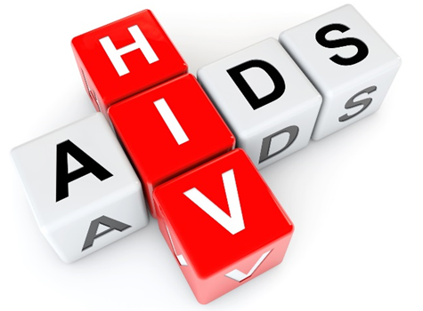
Ukungasebenzi kwamayeza ii ARV kunganqandwa njaningeli xesha kuthathwa inxaxheba kwi-HOPE?
1. Nqanda ufumana I HIV: Ukungasebenzi kwamayeza ARV akunakwenzeka kumntu ongenayo I HIV.
Notes:
Zininzi izinto ongazenza ukunciphisa umngcipheko we-HIV:

Slide 12
Ukungasebenzi kwamayeza ii ARV kunganqandwa njaningeli xesha kuthathwa inxaxheba kwi-HOPE?
Sebenzisa iringi ene-dapivirineefakwa ekukwini rhoqo
Sebenzisa iikhondom rhoqo

Slide 13
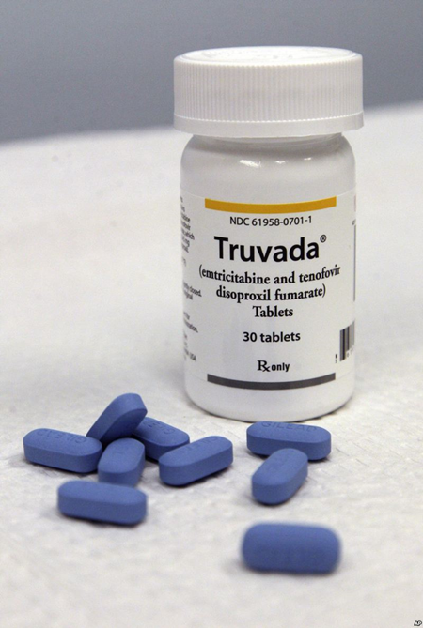
Ukungasebenzi kwamayeza ii ARV kunganqandwa njaningeli xesha kuthathwa inxaxheba kwi-HOPE?
Sebenzisa i-PrEP eselwayo (umz. i-Truvada)
Nciphisa inani lamaqabane akho owabelana nawo ngesondo
Sebenzisa iindlela zokwabelana ngesondo ezinomngcipheko ophantsi

Slide 14
Ukungasebenzi kwamayeza ii ARV kunganqandwa njaningeli xesha kuthathwa inxaxheba kwi-HOPE?
Ukuba une-STI, fumana unyango
Khuthaza iqabane lakho ukuba livavanyelwe i-HIV
Ukuba iqabane lakho line-HIV, bakhuthaze ukuba bathathe amayeza abo e-ARV
Notes:
Buza umcebisi wakho malunga namaphetshana “angoLwazi ngeeNdlela zokuThintela i-HIV” nangeenkcukacha ezithe vetshe ngezi ndlela

Slide 15
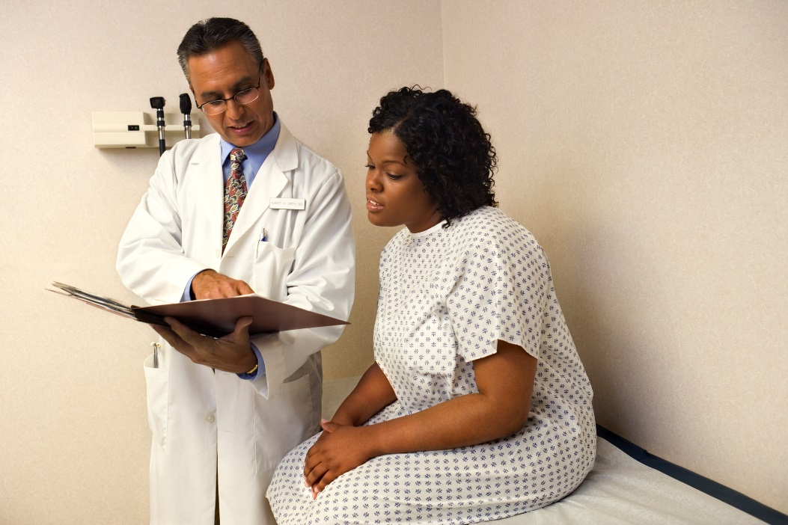
Ukungasebenzi kwamayeza ii ARV kunganqandwa njaningeli xesha kuthathwa inxaxheba kwi-HOPE?
2. Yenza uVavanyo lwe-HIV lwaRhoqo:
Uvavanyo lwe-HIV luza kwenziwa kutyelelo lophando ngalunye.
Kufanele kanjalo uze ekliniki uvavanyelwe i-HIV ukuba ucinga uye wosuleleka yi -HIV phakathi kotyelelo.

Slide 16
Ukungasebenzi kwamayeza ii ARV kunganqandwa njaningeli xesha kuthathwa inxaxheba kwi-HOPE?
Ukuba uvavanyo lubonisa ukuba une-HIV, kubalulekile ukuyeka kwamsinya ukusebenzisa iringi efakwa ekukwini ukuze uncede ukuthintela ukungavi (mayeza).
Notes:
Ukuba uphose utyelelo lophando, umthathi-nxaxheba angafumana i-HIV, angayazi, aze aqhubeke nokusebenzisa iringi. Oku kungabangela ukungasebenzi kwamanye amayeza e-ARV.

Slide 17
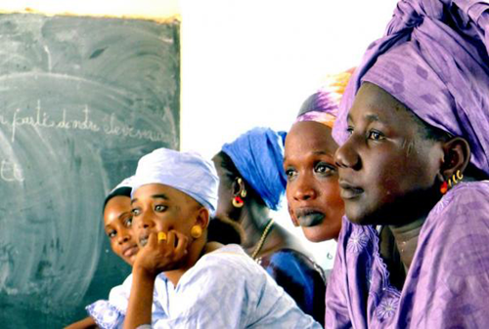
Ukungasebenzi kwamayeza ii ARV kunganqandwa njaningeli xesha kuthathwa inxaxheba kwi-HOPE?
3. Musa ukwaBelana ngeeRingi ezifakwa eKukwini:
Abathathi-nxaxheba abakuphononongo lophando bafumana ukuxilongelwa kwezempilo lwarhoqo neemvavanyo ze-HIV.
Abantu abangekho kuphando abalufumani olu xilongo lwezempilo. Aba bantu basenganayo i-HIV, kwaye bangayazi.
Notes:
Ukuba abantu abane-HIV basebenzisa iringi efakwa ekukwini, oku kungabangela ukungeva amanye amayeza e-ARV.

Slide 18
Ukuba unemibuzo okanye ufuna ulwazi oluthe vetshe, nceda undwendwele ikliniki yophando
Notes:
Abasebenzi bophando bakhona ukuze bakuncede.
Abasebenzi bophando bakhona ukuze bakwazise baze bacebise abathathi-nxaxheba bophando, amaqabane abo, namanye amalungu okuhlala malunga nokungasebenzi (kwamayeza) nayo nayiphi na imibuzo okanye iinkxalabo abanganazo.

